Slide 1
Microprocessor Design
TAs: Sebastian Giraldo, Nathan Laubeuf,
Jasper Marien, Linyan Mei, Giuseppe Sarda

Slide 2
Outline
Intro (support platforms)
Objectives of the sessions
Tools used
Architecture
Loading Programs
Exercises

Slide 3


Communication platform – Discord server
On the server you can find:
Useful resources
A dedicated channels for each group
Dedicated rooms for communication with TAs
Ticketing system to ask for help from TAs

Slide 4

Keep your project safe!
We highly suggest you to use git as a versioning tool.
It helps you to:
keep track of modifications
automatically sync the project between group members
allow TAs to support you more easily
Please have a look on the dedicated guide.

Slide 5

Objective
Design a microprocessor in RTL (Verilog) using 32 nm technology
Evaluate different microarchitectures
Single Cycle Processor
Single Cycle Processor (Multiplication Support)
Pipelined Processor (without data-hazard resolution)
Pipelined Processor (with data-hazard resolution)
Compare
Performance
Hardware Resources

Slide 6

Objective
Optional:
Single Cycle Processor (Not Functional)
Single Cycle Processor
Single Cycle Processor (Multiplication Hardware)
Pipelined Processor
Pipelined Processor (Data-Hazard resolution)
RISCV processor
(Optional technique)
SIMULATION + SYNTHESIS
reports
Comparison of Microarchitectures

Slide 7
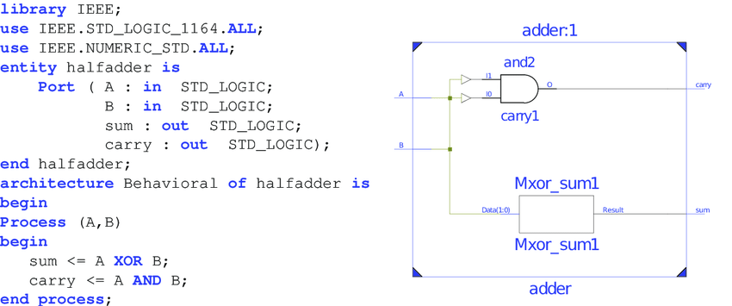
Tools used
Simulation: NC Verilog (Cadence)
“Check the correctness of the hardware description implemented”
Synthesis: Design Vision (Synopsys)
“Convert a hardware description into physical gates”

Slide 8
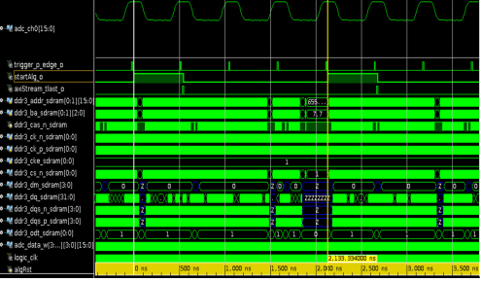
Tools used: Simulation
Script to be loaded: incisiv_15.20.058.rc
Command used: make nc_gui or make nc
Testbench (cpu_tb.v)
NC Verilog
Hdl files
Simulation Results

Slide 9
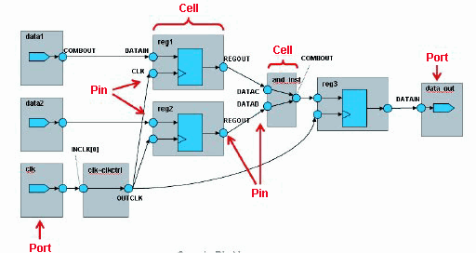

Tools used: Synthesis
Scripts to load tool: synopsys_2017.09.rc
Command used: source synthesis.sh
Libraries (lib)
Constraints (sdc)
Netlist
Design Vision
HDL files
Area/Timing/Power Reports

Slide 10
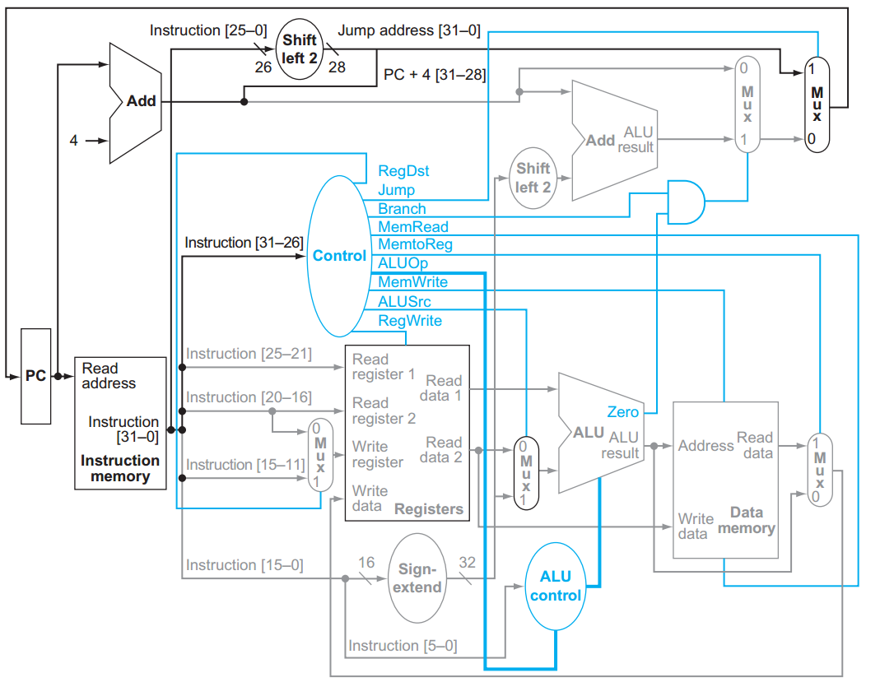
Architecture Used
Single Cycle Processor

Slide 11
Architecture Used
cpu_tb
cpu
control_unit
program_
counter
register_file
branch_unit
alu
alu_ctrl
instruction_
memory
data_memory
regfile_dest_mux
alu_operand_mux
regfile_data_mux

Slide 12
Architecture Used
Control_unit
File: control.v

Slide 13
Architecture Used
register_file
File: register_file.v

Slide 14
Architecture Used
program_counter
File: pc.v
(Be careful, there is
more logic)

Slide 15
Architecture Used
branch_unit
File: branch_unit.v

Slide 16
Architecture Used
alu
File: alu.v

Slide 17
Architecture Used
alu_ctrl
File: alu_control.v

Slide 18
Architecture Used
Instruction memory
File: sram.v
Data Memory
File: sram.v

Slide 19
Architecture Used
Regfile_data_mux File: mux_2.v
Alu_operand_mux File: mux_2.v
Regfile_dest_mux File:mux_2.v

Slide 20
Programs
MIPS language
2 extra instructions
NOP (opcode: 111111)
STOP (opcode: 111110)
5 programs
Simple_program
MULT1
MULT2
MULT3
OPTIONAL4
How to load a program?
Go to SIM/data and modify
Imem_content.txt
Dmem_content.txt

Slide 21
Programs
Functions of Testbench (cpu_tb.v)
cpu_tb
dmem_content
Stimulation Logic
CPU
imem_content
Design Vision
Loading Data Memory
Loading Instr. Memory
Design Vision
Execution
Check
Start of Program
End
of Program

Slide 22
Programs
addi $s0, $0, 7
addi $s1, $s0, 2
sw $s1, 0($0)
lw $s2, 0($0)
add $s3, $s0, $s2
beq $s1,$s2, FINAL
add $s4, $s0, $s1
FINAL: add $s5, $s2,$s3
simple_program

Slide 23
Programs
When there is no hardware support: Mult1
1 1 0
X 1 0 1
1 1 0
0 0 0
1 1 0
1 1 1 1 0
The same as the Sum of:
110 (Shifting “110” by 0 positions)
0000 (Shifting “000” by 1 position)
11000 (Shifting “110” by 2 positions)
Algorithm:
Acc = 0
N = operand1
Traverse each bit of operand2 (LSB -> MSB)
If the bit of operand2 is 1, accumulate. Acc = Acc + N.
If the bit is 0, Acc = Acc.
Left shift N by 1 position.

Slide 24
Instr. Memory
Data Memory
1
2
3
4
5
6
7
8
9
a
Programs
add $20, $20, $22
SHIFTING_0: sll $22, $22, 1
sll $19, $19, 1
addi $23,$23,-1
beq $23, $0, M2
j LOOP_0
M2: add $9, $9, $20
addi $16, $16, -8
addi $8, $8, 8
beq $16, $0, FINISH
j M1
FINISH:
addi $16,$0,40
addi $8, $0, 0
addi $9, $0, 0
M1:lw $17, 0($8)
lw $18, 4($8)
addi $23, $0, 32
addi $19, $0, 1
addi $20, $0, 0
add $22, $0, $17
LOOP_0: and $21, $18, $19
beq $21, $0, SHIFTING_0
MULT1
It makes 5 multiplications with 10 integers.
The results are summed together.
** Based on sums and shifts
$16: Total size of data memory
$8: Data Memory Pointer
$23: Iteration over the number of bits
$20: Accumulated result of each multiplication
$9: Final result

Slide 25
Instr. Memory
Programs
lw $8, 0($0)
lw $9, 4($0)
lw $10, 8($0)
lw $11, 12($0)
lw $12, 16($0)
lw $13, 20($0)
lw $14, 24($0)
lw $15, 28($0)
lw $16, 32($0)
lw $17, 36($0)
Data Memory
1
2
3
4
5
6
7
8
9
a
Addi $23, $0, 0
nop
nop
nop
Add $23, $23, $18
nop
nop
nop
Add $23, $23, $19
nop
nop
nop
Add $23, $23, $20
nop
nop
nop
Add $23, $23,$21
nop
nop
nop
add $23, $23,$22
MULT2
** Use of mult instruction
mult $18, $8,$9
mult $19, $10, $11
mult $20, $12, $13
mult $21, $14, $15
mult $22, $16, $17

Slide 26
Instr. Memory
Programs
lw $8, 0($0)
lw $9, 4($0)
lw $10, 8($0)
lw $11, 12($0)
lw $12, 16($0)
lw $13, 20($0)
lw $14, 24($0)
lw $15, 28($0)
lw $16, 32($0)
lw $17, 36($0)
Data Memory
1
2
3
4
5
6
7
8
9
a
Addi $23, $0, 0
Add $23, $23, $18
Add $23, $23, $19
Add $23, $23, $20
Add $23, $23,$21
add $23, $23,$22
MULT3
** Use of mult instruction
** No NOPS between
Data-dependent
instructions
mult $18, $8,$9
mult $19, $10, $11
mult $20, $12, $13
mult $21, $14, $15
mult $22, $16, $17

Slide 27
Exercise
Session 1:
Complete Single Cycle Processor
Add support for Multiplication
Session 2:
Pipelined Processor (without data-hazard resolution)
Session 3:
Pipelined Processor (with data-hazard resolution)
Optional Exercise:
Porting the code to support RISC-V ISA
(a dedicated presentation will be provided)

Slide 28
REMARKS
The assignments must be completed in groups of 2 people.
Important: Make sure at least one student in a group has Verilog experience.
After completing each one of the exercises, the results must be shown to the TAs for its correspondent evaluation.
The code must be delivered to the TAs in the final session.
Also you will hand in a small report based on the template that you find in the folder. Together with the performance of your final processor, this counts for 2 points in the final H05d3A grade.
This report should be handed in through Toledo. The deadline will be set and communicated to you.

